Slide 1
Artificial Intelligence and Machine Learning Project
[ Team -12 ]
Karan Kumar Garg: 2210990478
Karanpreet Singh : 2210990482
Karishma Dhawan : 2210990483
Lokesh Garg : 2210990544
Faculty Coordinator: Ms. Shagun Sharma
Chitkara University Institute of Engineering and Technology,
Chitkara University, Punjab

Slide 2
Table of Contents
Introduction
Problem Statement
Technical Details
Key Features
Conclusion
Results
References/Links used

Slide 3
Introduction
Finding the perfect rent can be tough! This project builds a friend to help you guess rent prices. We feed it information about houses already rented, like size, bedrooms, and location. By learning from this data, it can predict rent for new houses you're interested in. Now you can find a place that fits your budget and avoid overpriced rentals.

Slide 4
Problem Statement
Finding the perfect apartment at the right price is a constant battle. Rents can vary wildly depending on location, size, amenities, and even random market fluctuations. Traditional methods like just looking at averages or asking around aren't always accurate. This project aims to tackle this challenge by creating a rent prediction tool. By analyzing data on past rentals, including things like size, bedrooms, and location, this tool will learn to predict rent prices for new listings. This can help you avoid overpriced apartments and find the perfect place that fits your budget.

Slide 5
Technical Details
Software Requirements:
Development Environment Languages: Python IDEs: Jupyter Notebook, PyCharm, VS Code
Data Handling and Preprocessing Storage: CSV (Comma separated File) Libraries: Pandas, NumPy Data Cleaning: Feature-engine
Machine Learning and Model Development Frameworks: Scikit-learn Visualization: Matplotlib, Seaborn, Plotly Evaluation: SciPy

Slide 6
Technical Details
Hardware Requirements:
Development Environment Processor: Multi-core processor (e.g., Intel Core i4 or higher) RAM: At least 4GB for handling datasets and models Storage: SSD storage with sufficient space for datasets and development environments
Model Training and Development GPU: Optional but recommended for accelerating model CUDA-enabled GPU: Required for GPU acceleration with TensorFlow or PyTorch

Slide 7
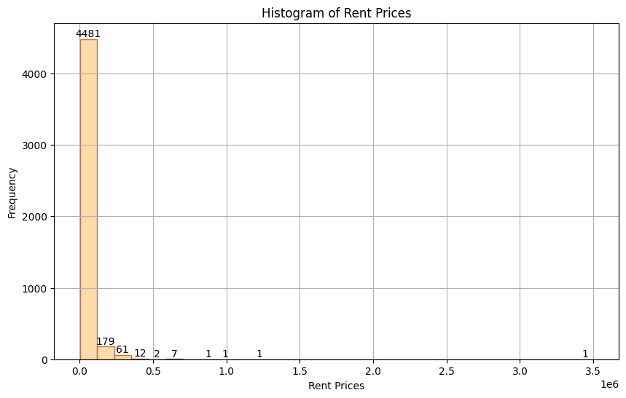
Project Highlights
It gives the Frequency of houses according to Rent Prices.

Slide 8
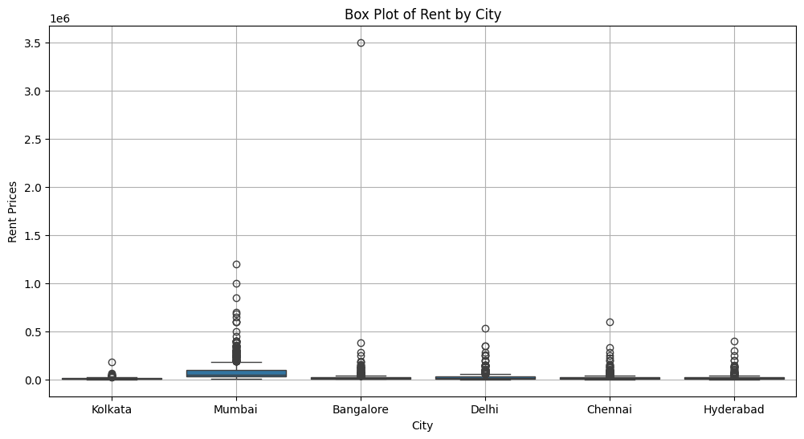
Project Highlights
It gives the Rent of houses according to City.

Slide 9
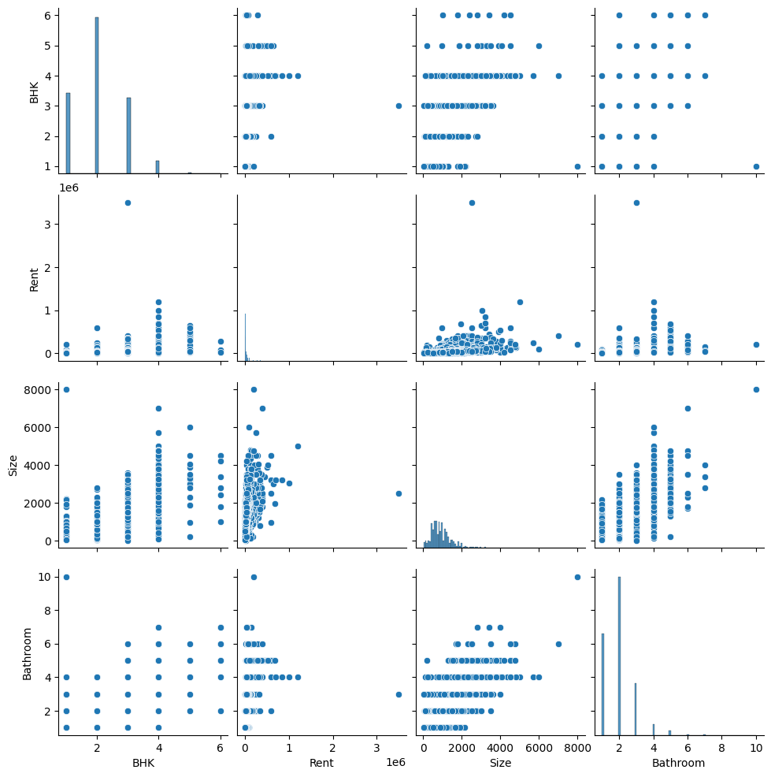
Project Highlights

Slide 10
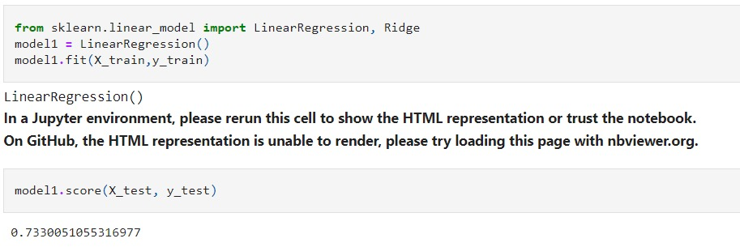
Results
Linear Regression Model
Library Used: sklearn
Time taken to train: 0.4 seconds
Model Accuracy: 0.7330051055316977 == 73.3%

Slide 11
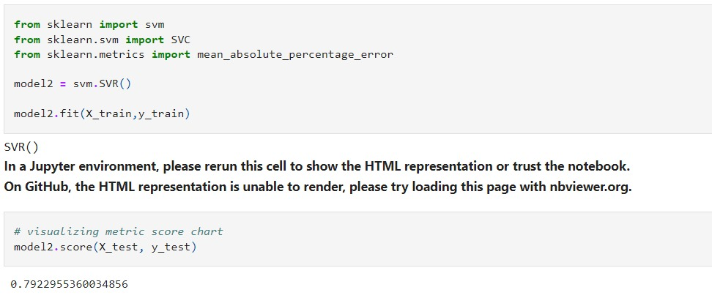
Results
Support Vector Machine (SVM) Model
Library Used: sklearn
Time taken to train: 0.6 seconds
Model Accuracy: 0.7922955360034856 == 79.2%

Slide 12
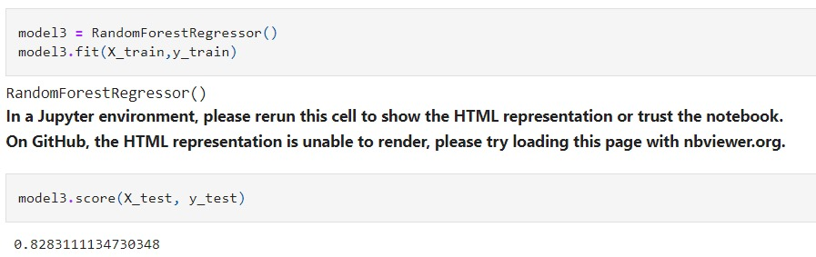
Results
Random Forest Regression Model
Library Used: sklearn
Time taken to train: 2.7 seconds
Model Accuracy: 0.8303840902289875 == 83%

Slide 13
Conclusion
Data-Driven Insights: AI models can analyze vast amounts of rental data, uncovering trends and relationships between various factors (like location, size, amenities) and rental prices.
Improved Accuracy: By considering these complex relationships, AI models can provide more accurate rent predictions compared to traditional methods.
Market Fluctuations: AI models can be trained to adapt to changing market conditions, offering more relevant predictions over time.
Informed Decisions: Landlords and renters alike can leverage these predictions for informed decisions - setting competitive rents or finding suitable housing within budget.

Slide 14
References/Links used
Pandas: https://pandas.pydata.org/docs/
Scikit-learn: https://scikit-learn.org/stable/
Matplotlib: https://matplotlib.org/stable/index.html
Seaborn: https://seaborn.pydata.org/
GitHub: https://github.com/

Slide 15


